Slide 1
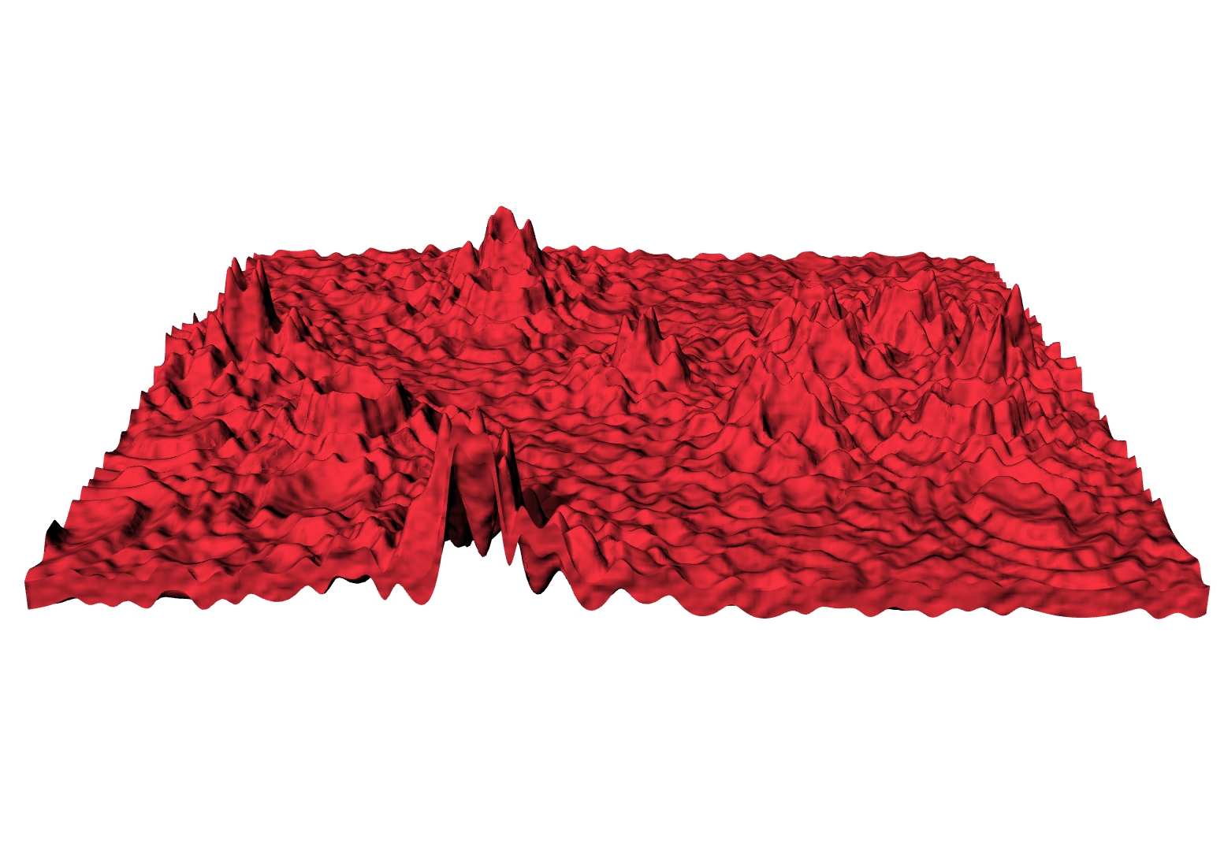
P#
<Computational Design Thinking>
<Parametric Design>
P#
BEST PICTURE
Assignment
Context
Course
Date
Parametric
Design
Freshmore
Term 1
Computational
Design Thinking
2020
Student
<Description>
Lim Thian Yew
1003158
This intention of this project is to design an aesthetically pleasing surface that also satisfies the practical constraints imposed by the need to 3D print the created surface.
The key challenge encountered is in trying to prevent an overly simplistic design, and in trying to overcome the constraint that individual points have heights that are calculated independently of one another.
<Overview>
To generate an interesting design, a set of coordinates is generated randomly and set to be ‘crater points’, and the height of all other points is determined based upon the it’s distance from the crater points. This makes the generated structure less homogeneous in nature, whilst still maintaining a semblance of structure and intentional design.
Instructor
Jason Lim
Instructor

Slide 2
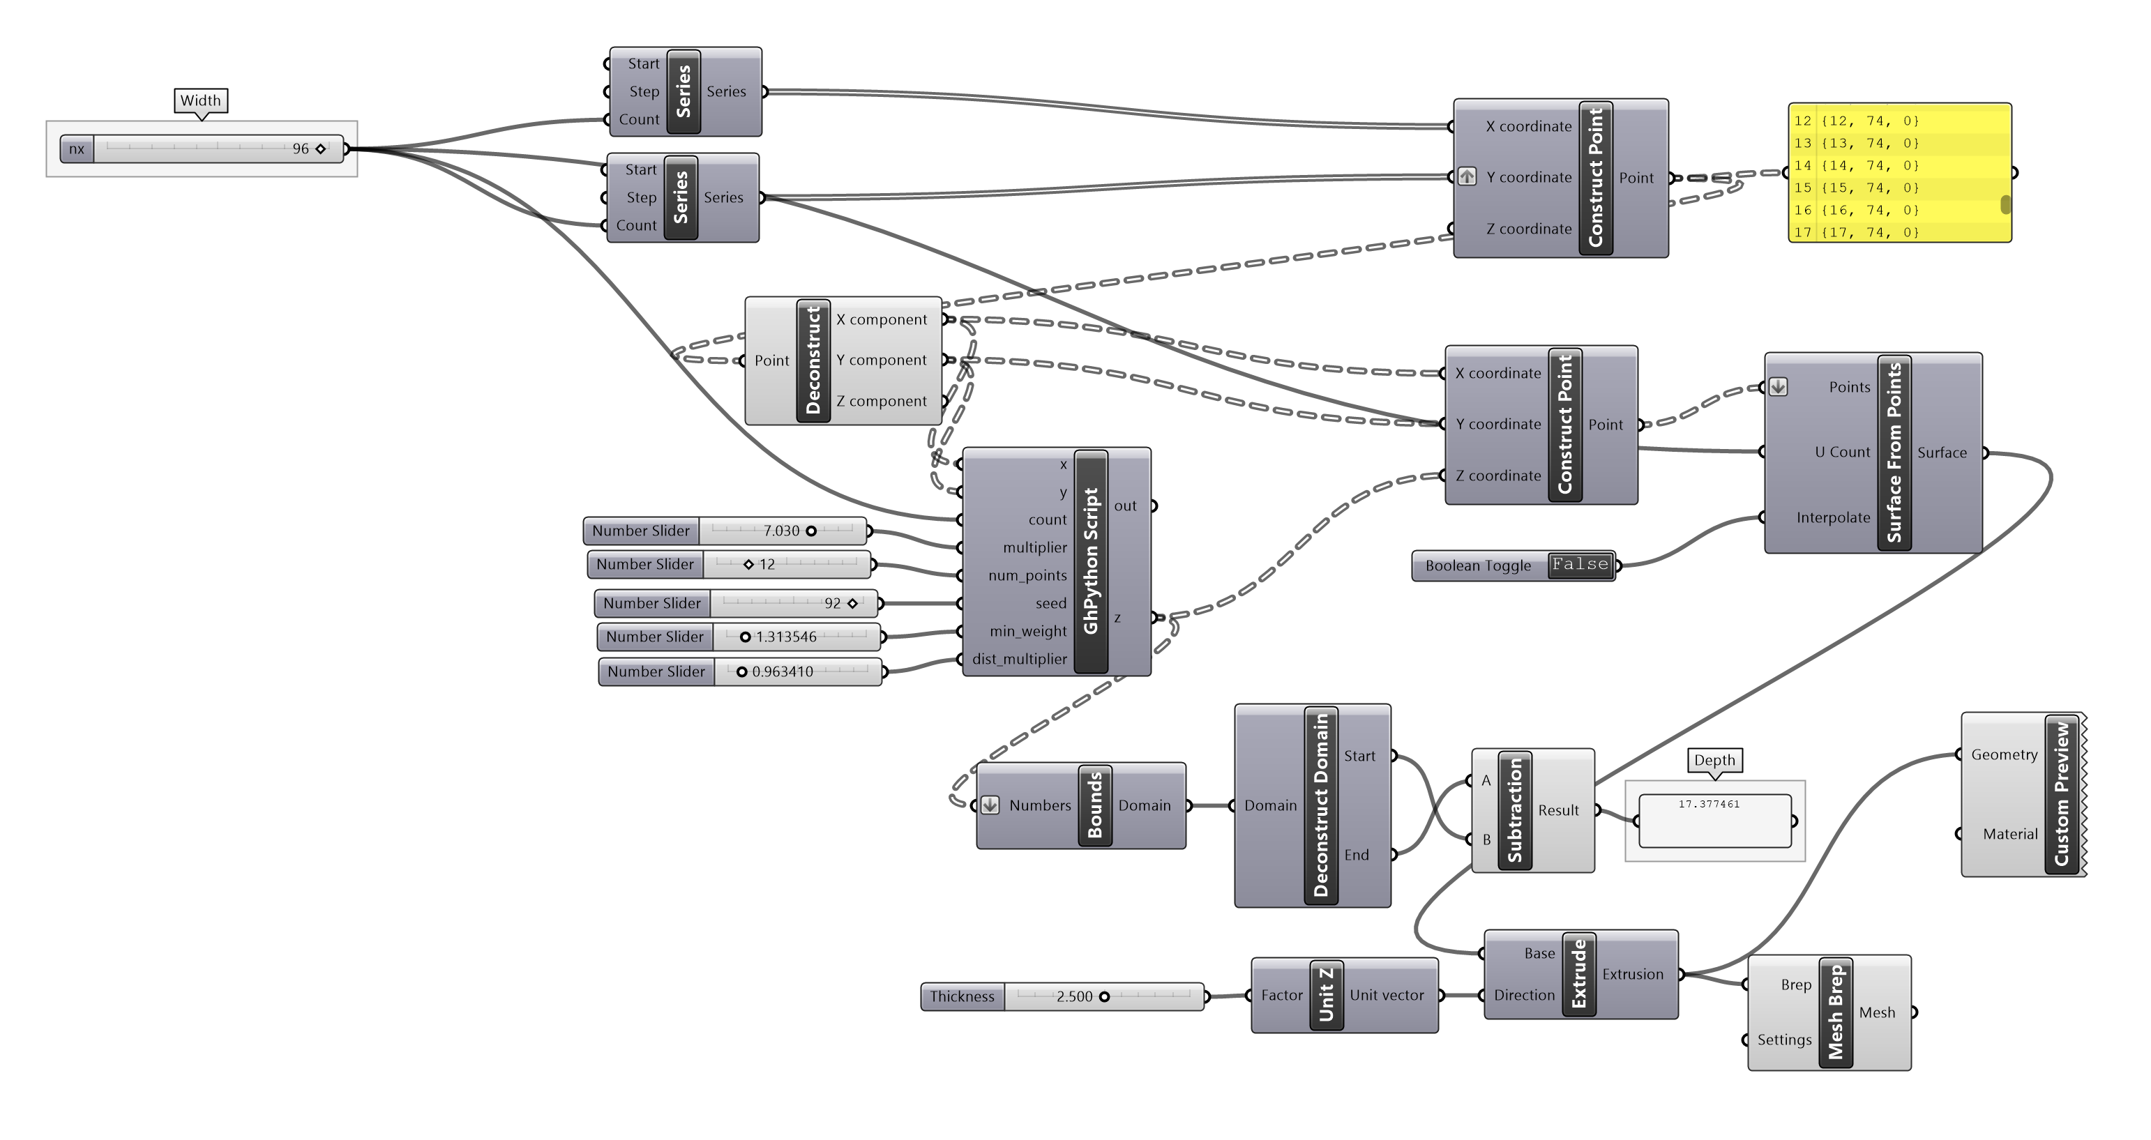
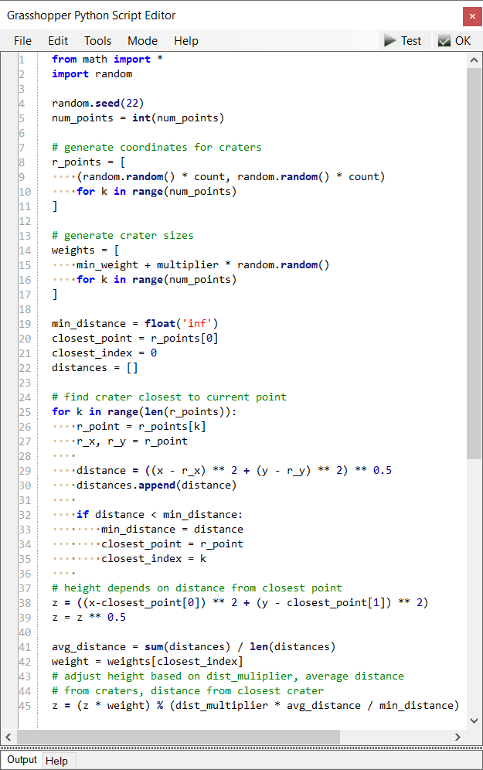
P#
<Computational Design Thinking>
<Parametric Design>
P#

Slide 3
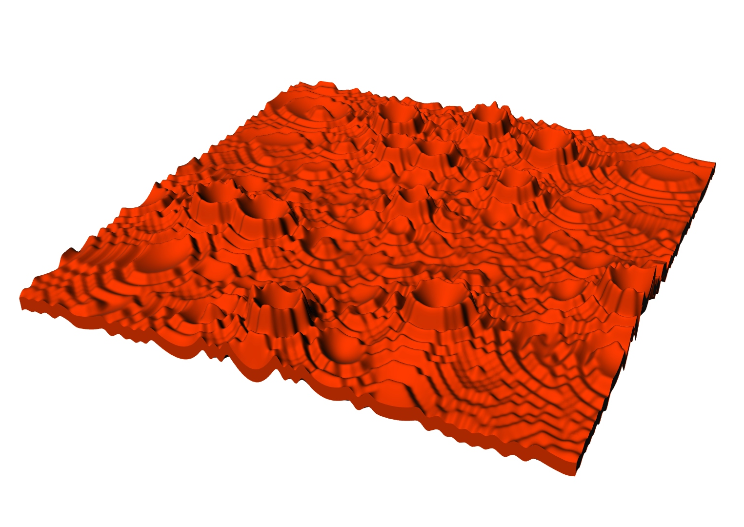
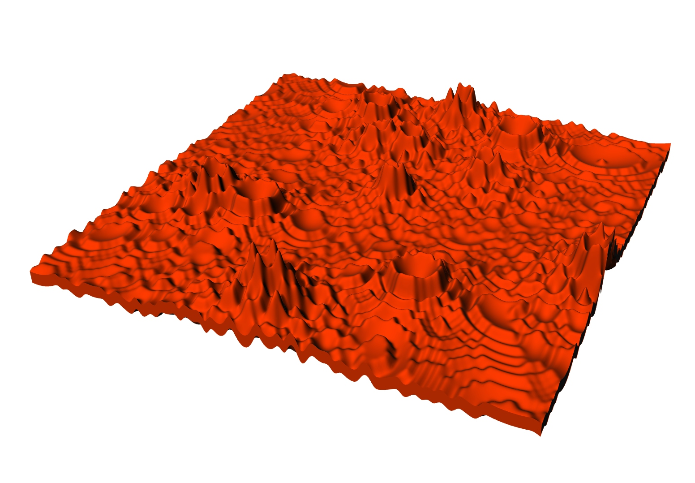

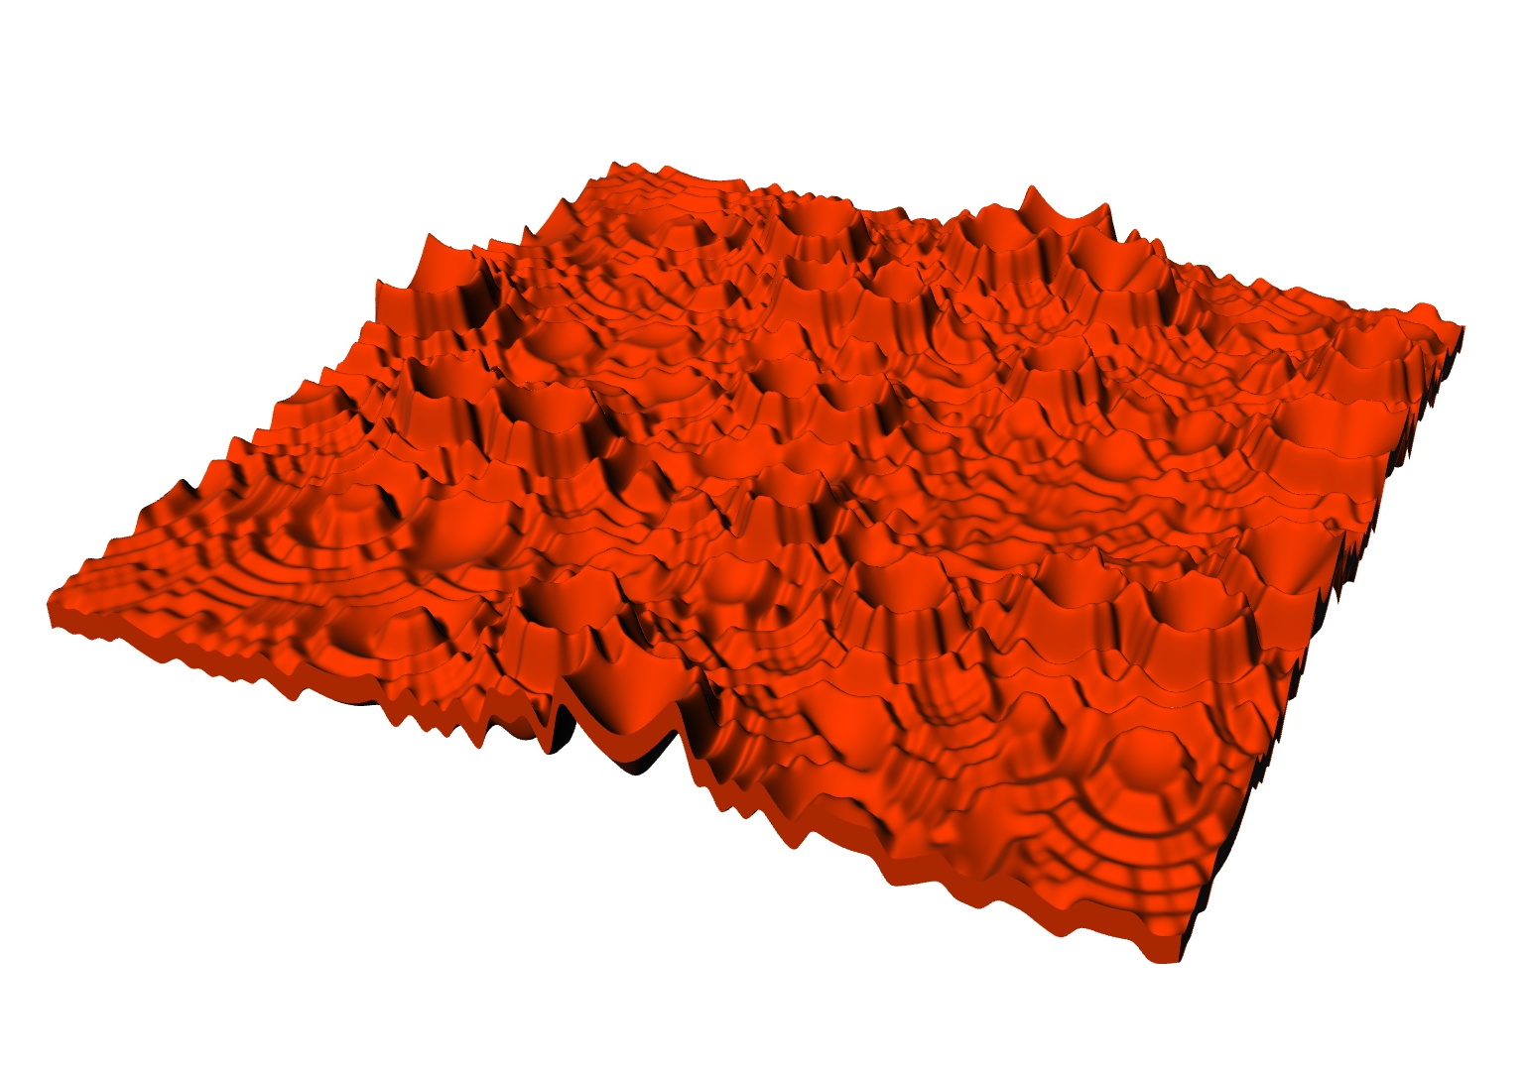
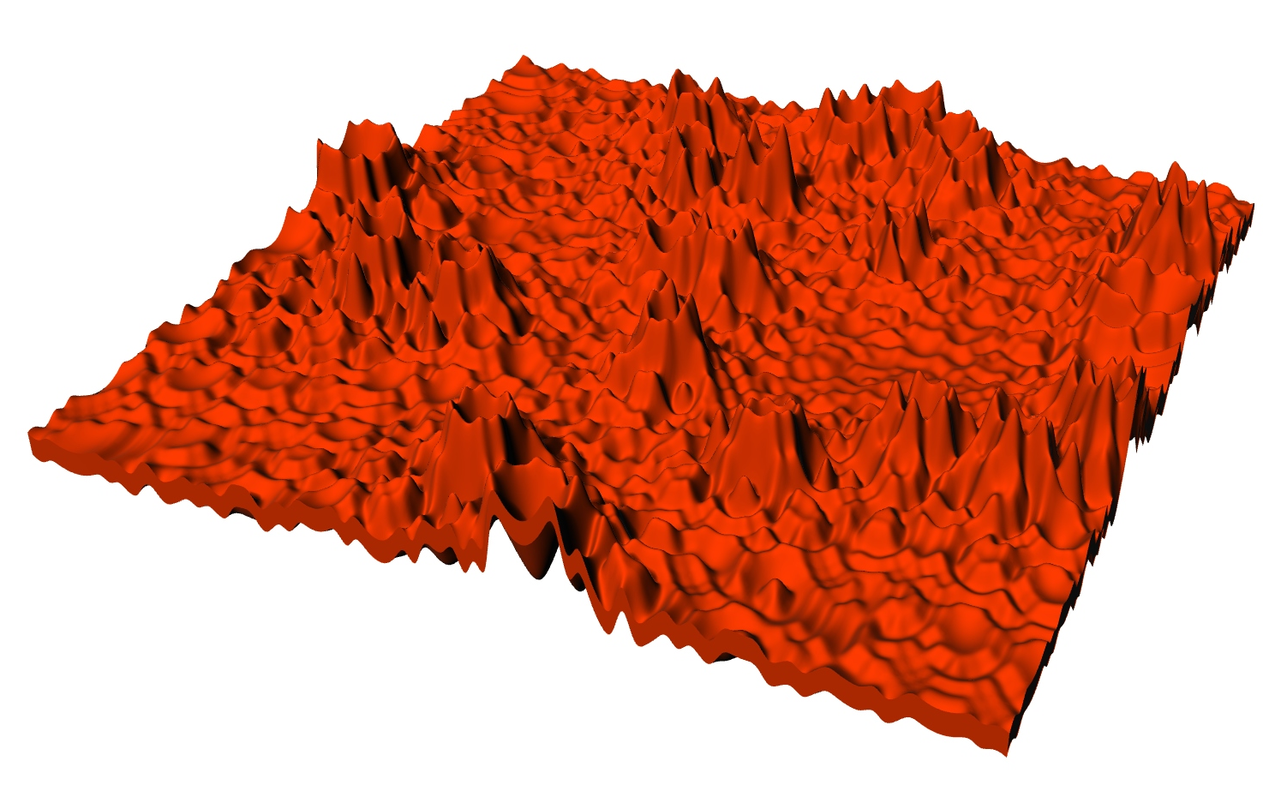
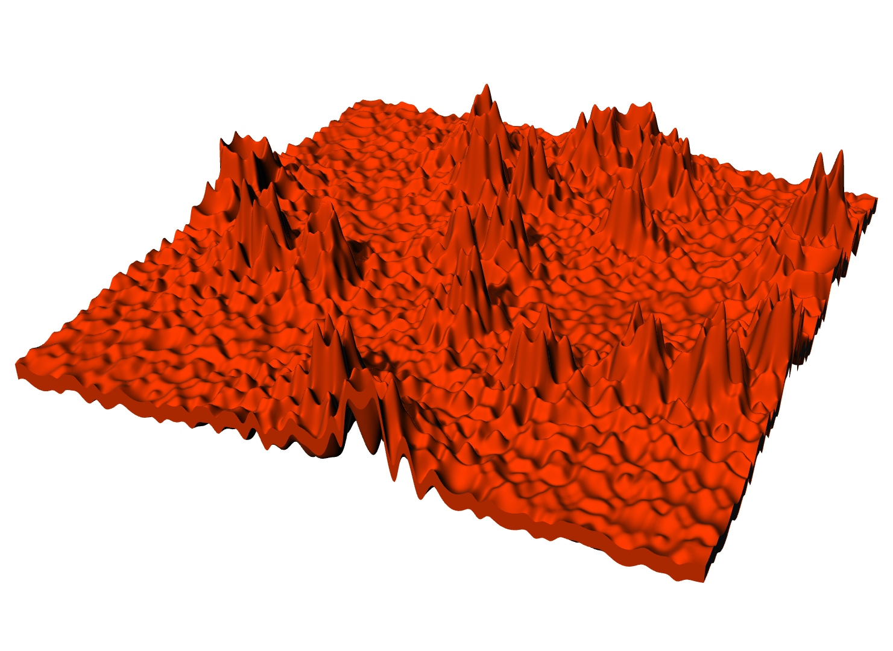
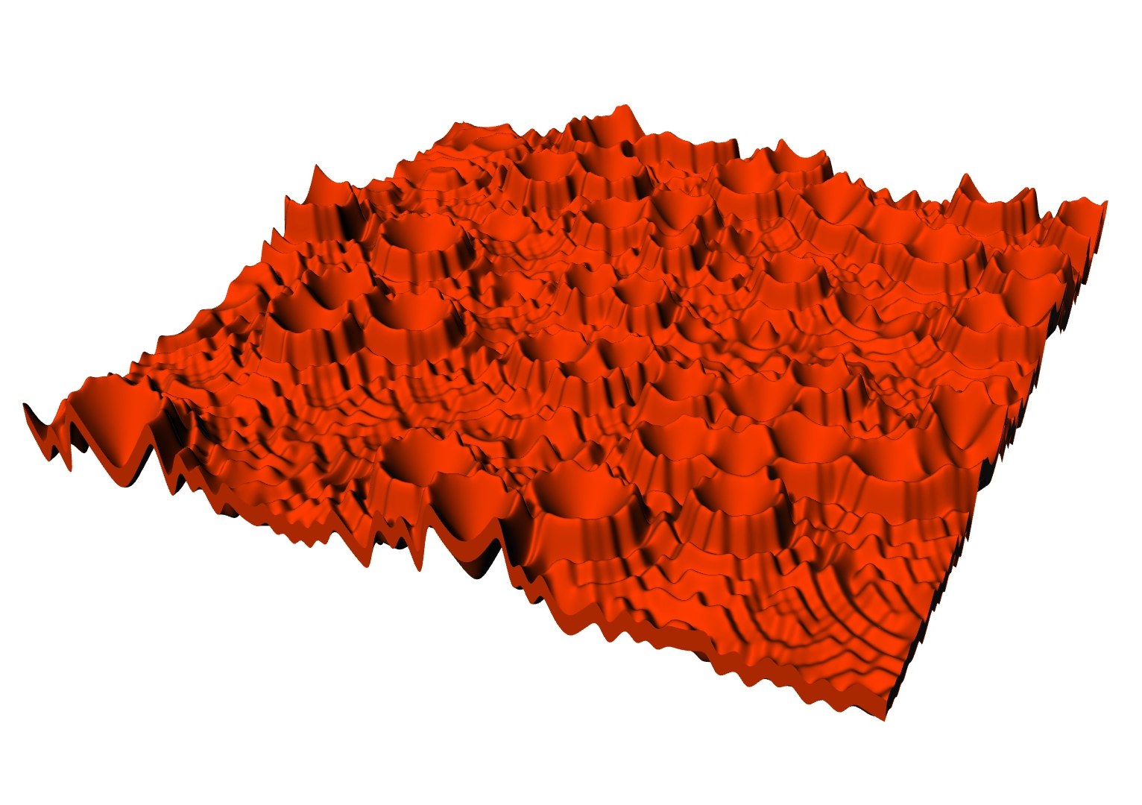
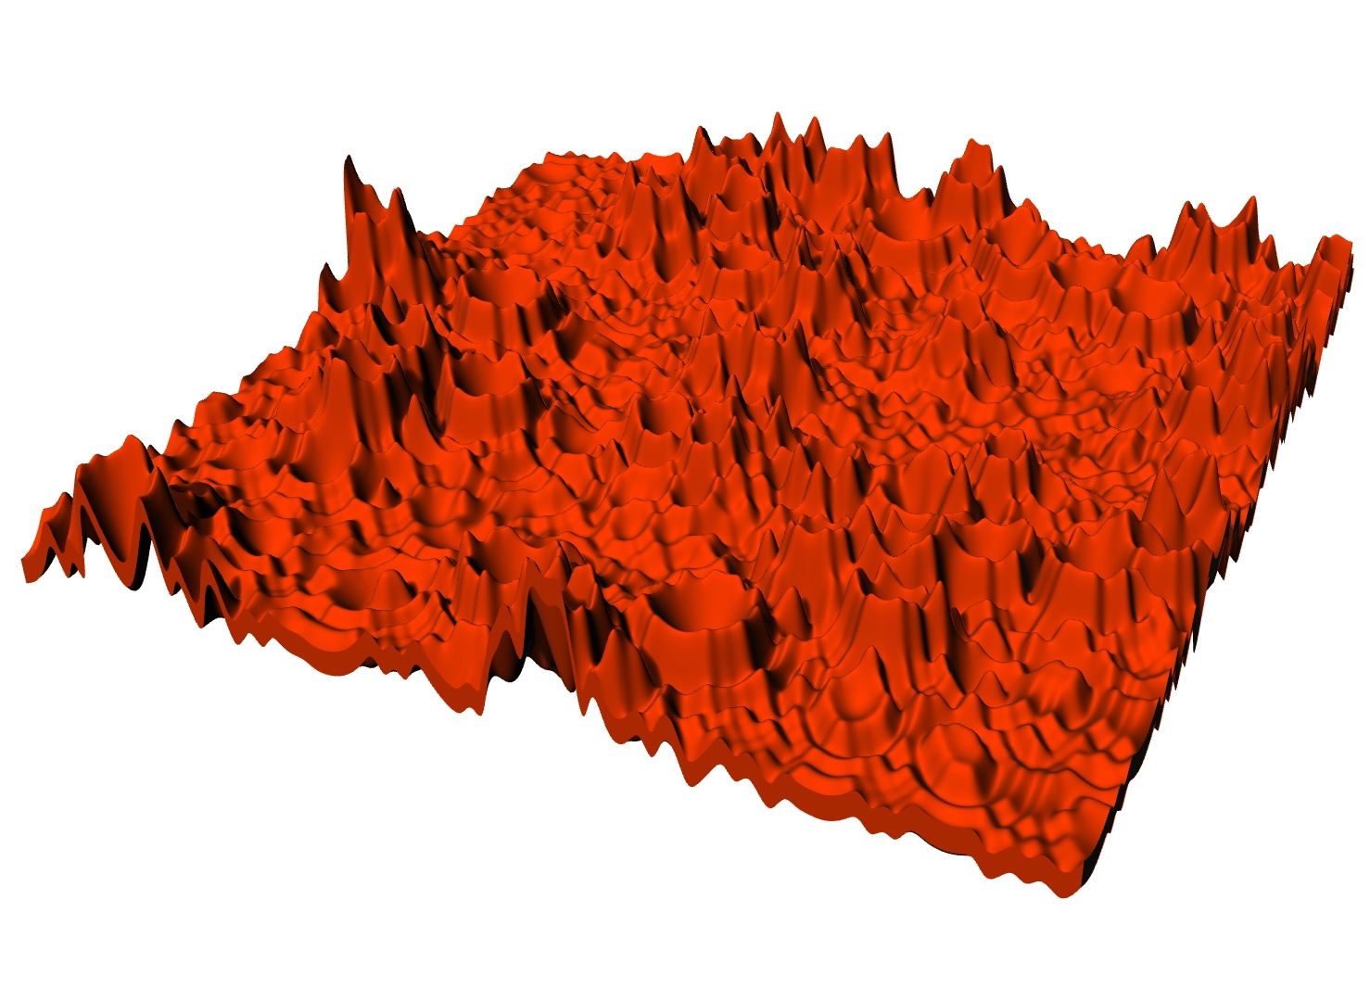
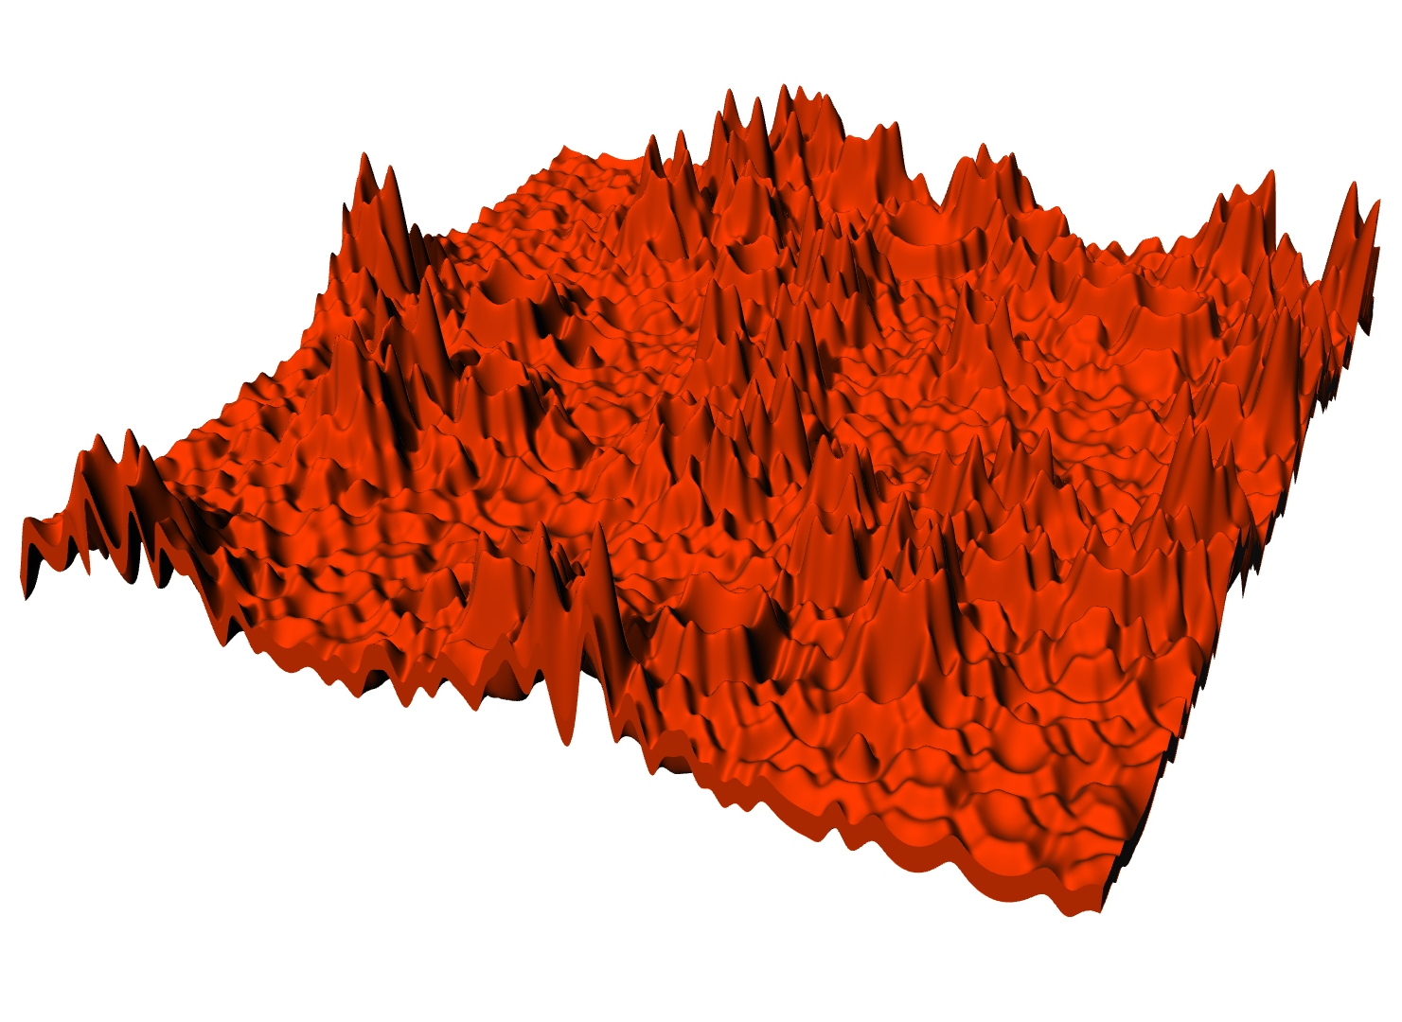
P#
<Computational Design Thinking>
<Parametric Design>
P#
multiplier (m) / number of craters (c)
1/8
1/8
1/8
m=1, c=12
m=5, c=12
m=10, c=12
1/8
1/8
1/8
m=1, c=24
m=5, c=24
m=10, c=24
Captions
01 m=1, c=12
02 m=5, c=12
03 m=10, c=12
04 m=1, c=24
05 m=5, c=24
06 m=10, c=24
07 m=1, c=50
08 m=5, c=50
09 m=10, c=50
1/8
1/8
1/8
m=1, c=50
m=5, c=24
m=10, c=50
01
02
03
04
05
06
07
08
09

Slide 4
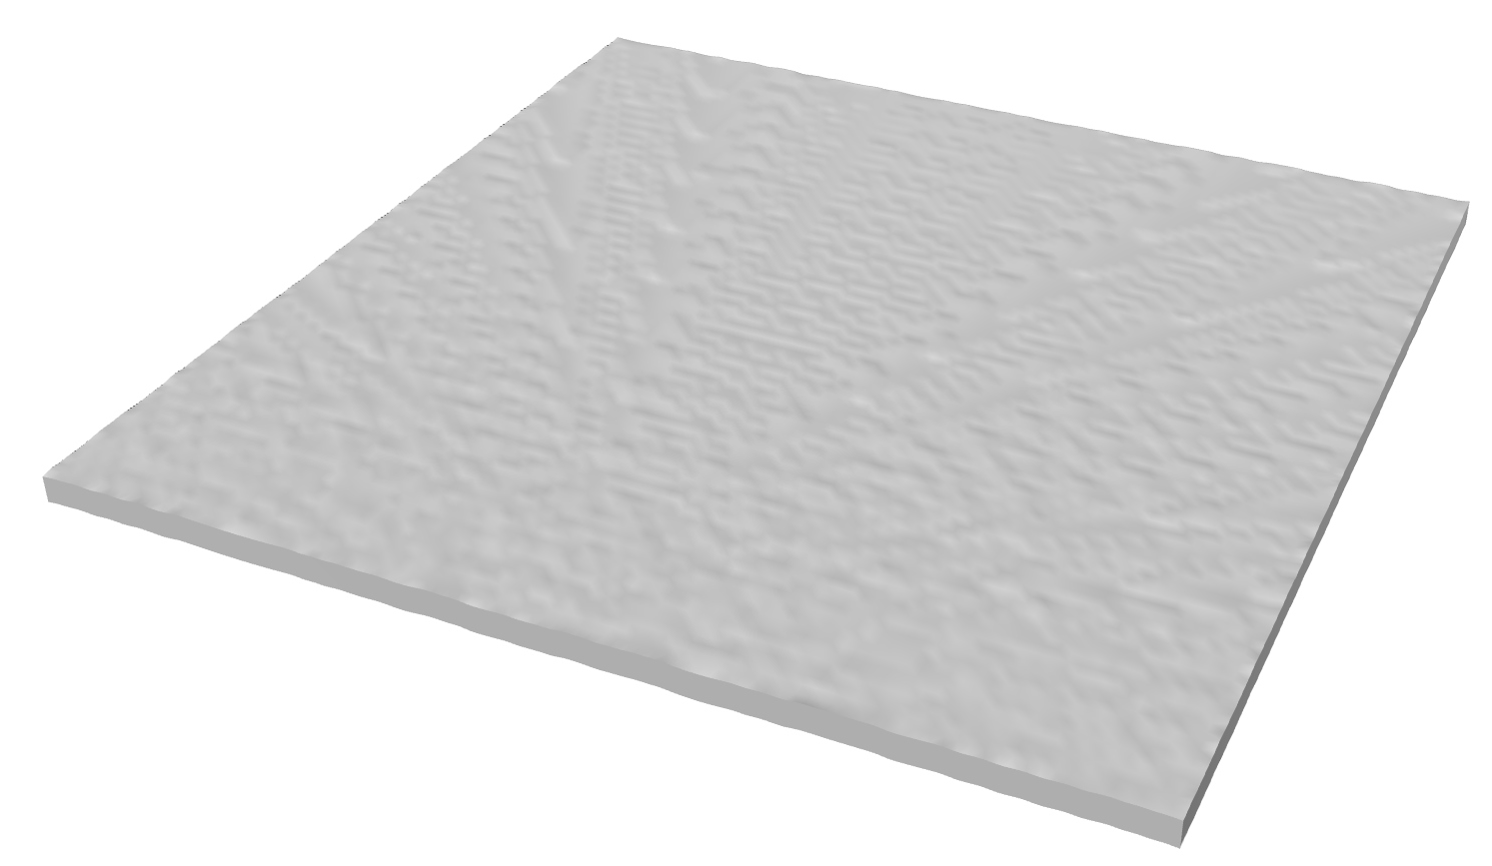
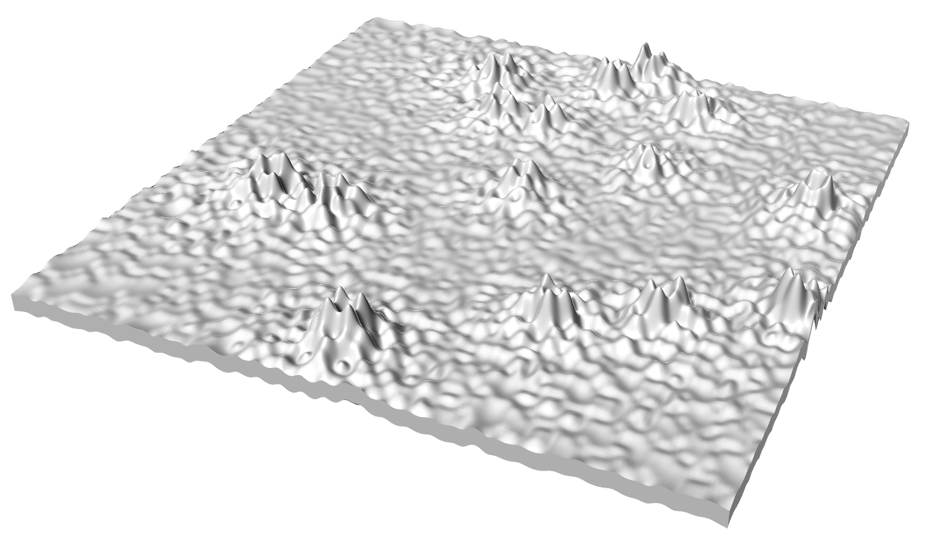
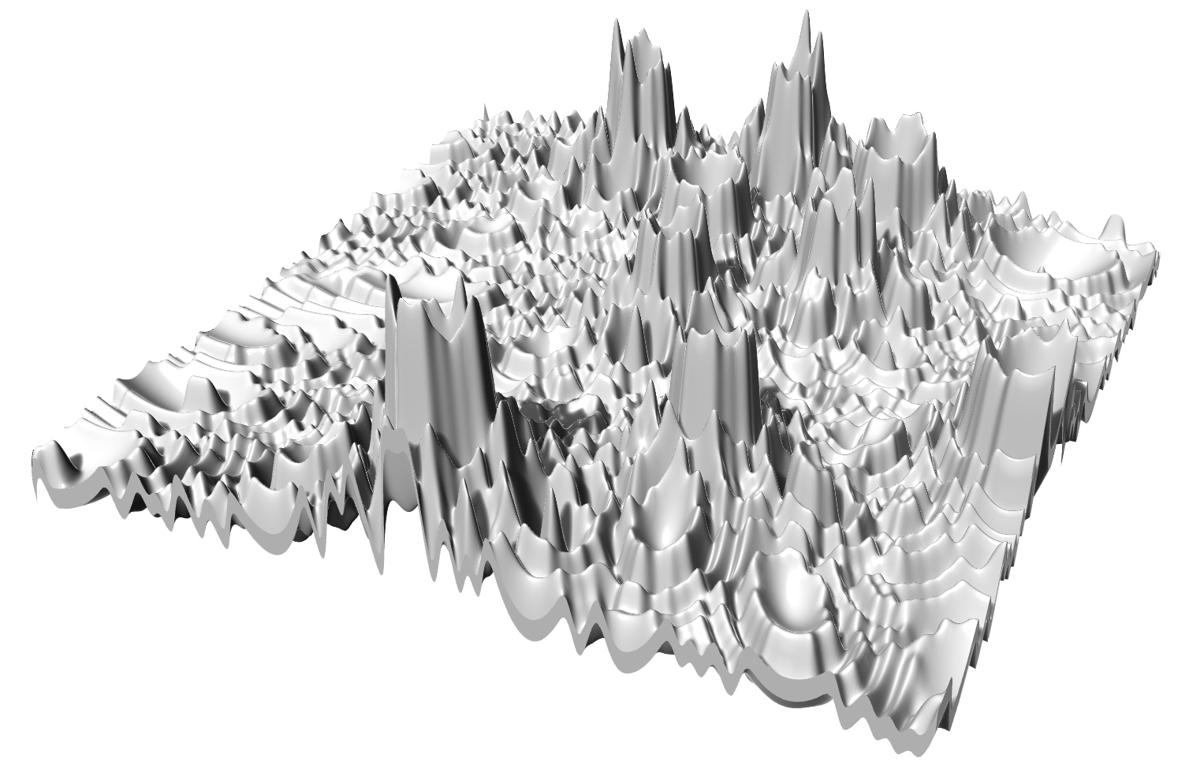
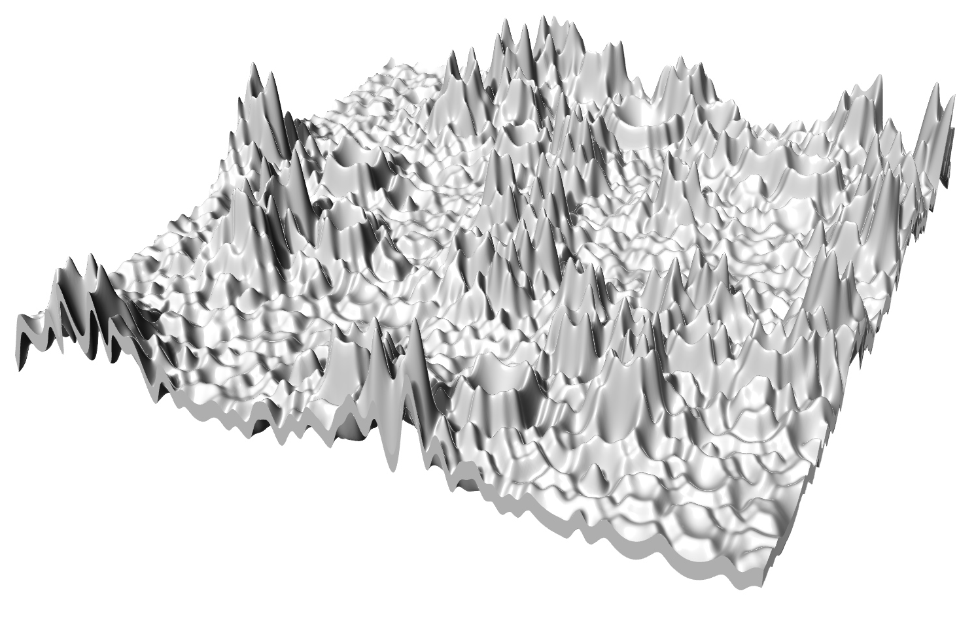
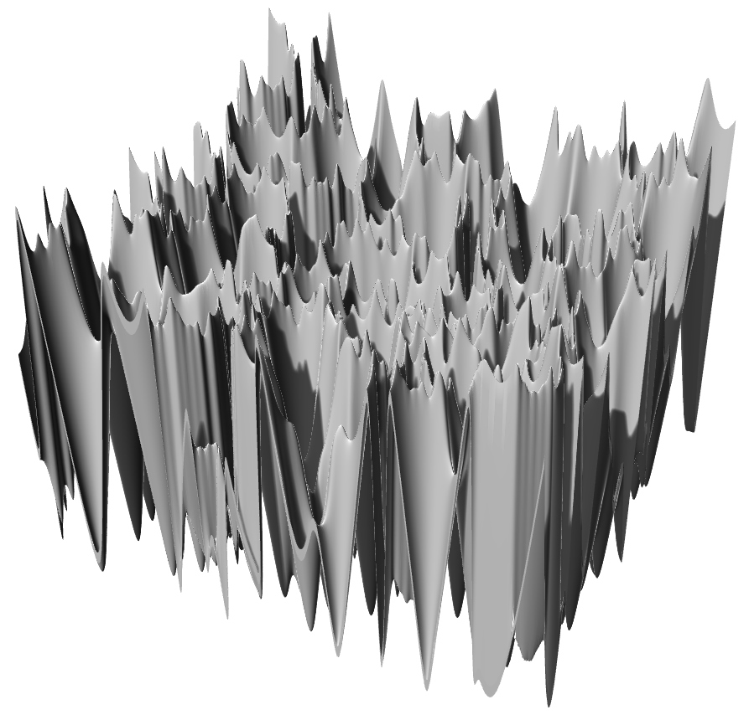
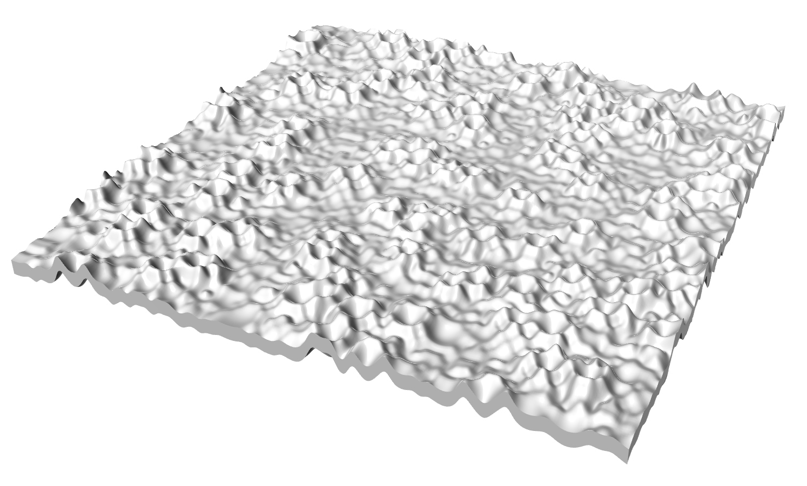
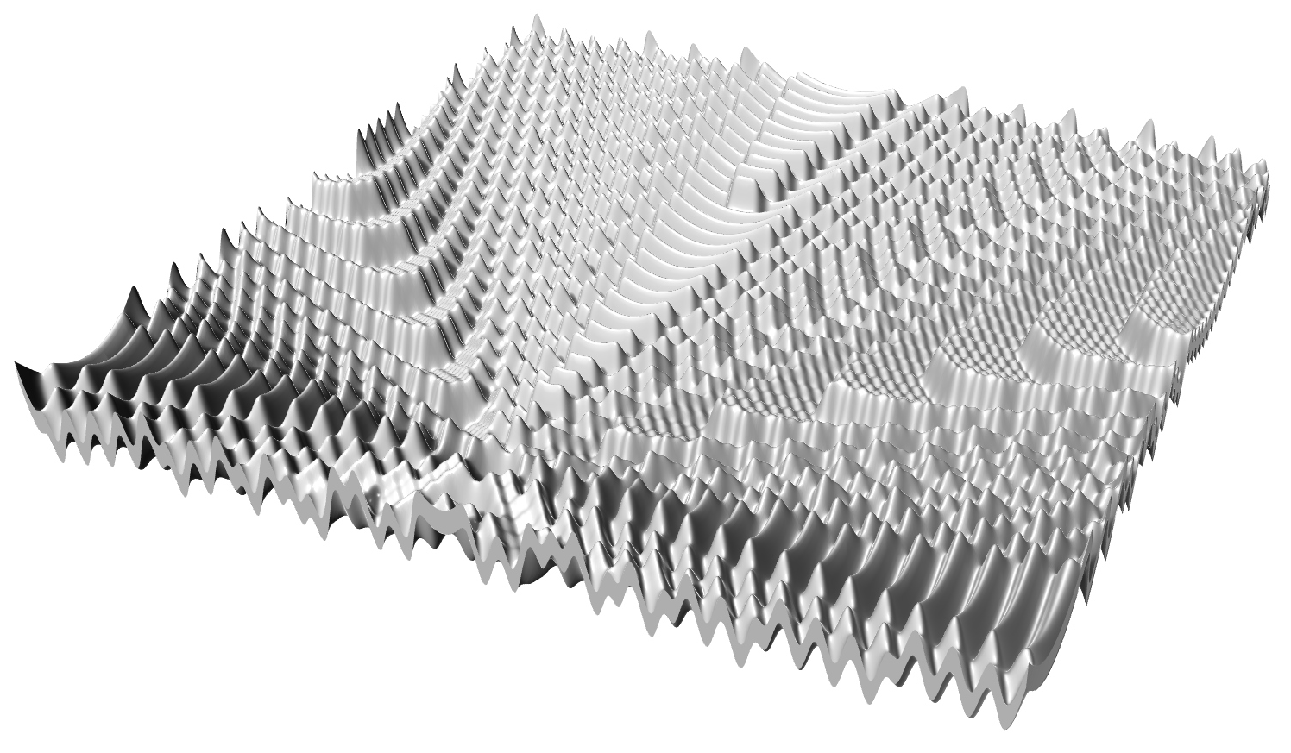
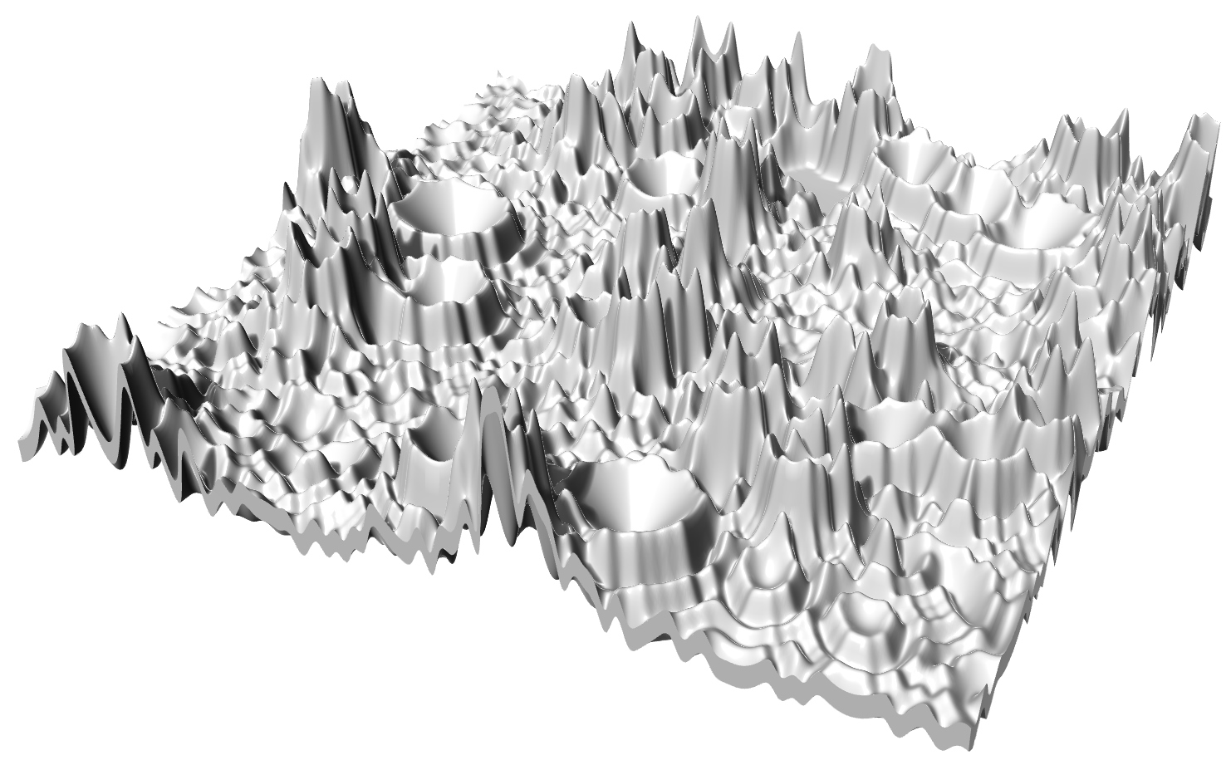
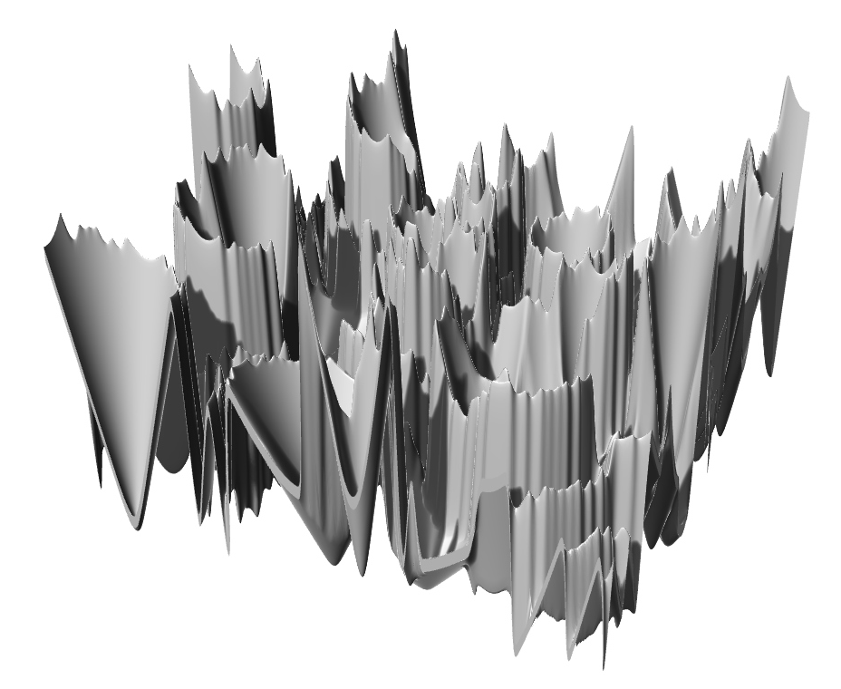
P#
<Computational Design Thinking>
<Parametric Design>
P#
Height (H) / desirability
1/8
1/8
1/8
Low
H=0.23mm
H=23.7mm
H=37.6mm
1/8
1/8
1/8
H=5.06mm
H=25.8mm
H=85.5mm
Medium
Captions
01 variations
1/8
1/8
1/8
H=10.0mm
H=35.3mm
H=71.1mm
01
High
Short
Medium
Tall

Slide 5
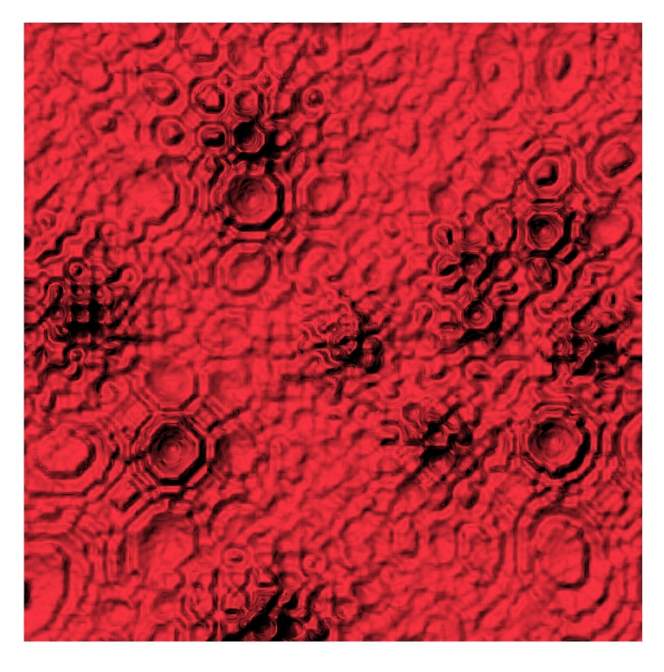
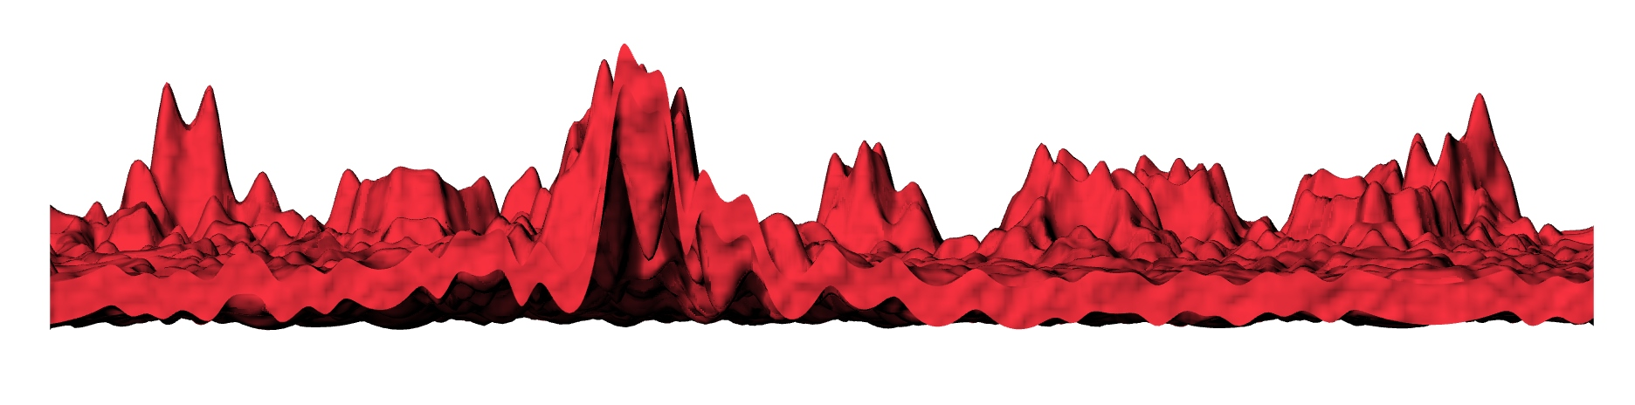
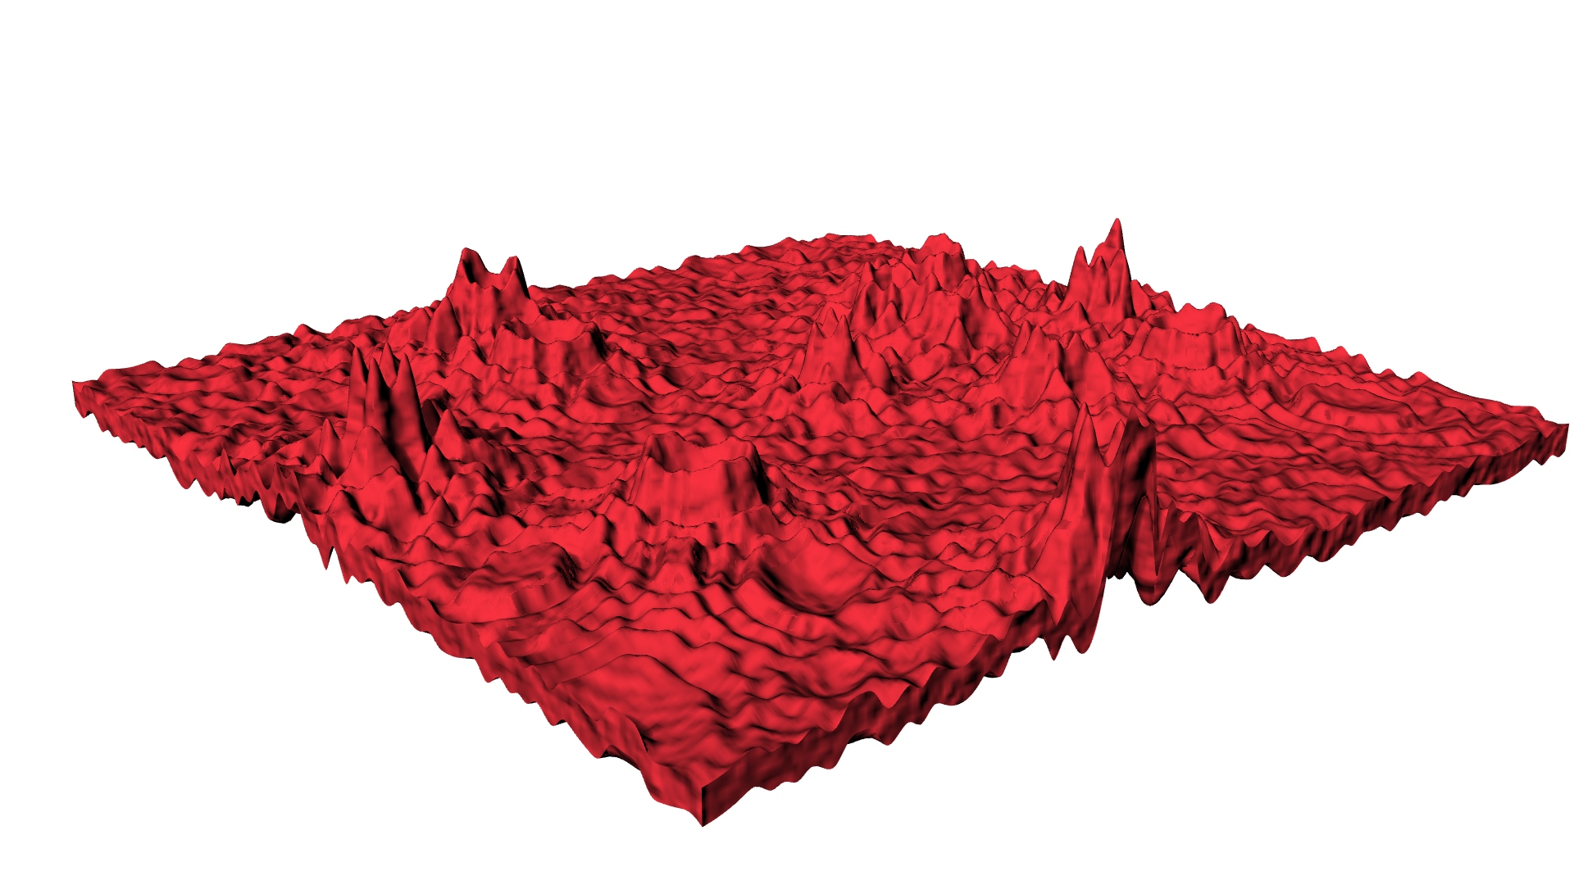
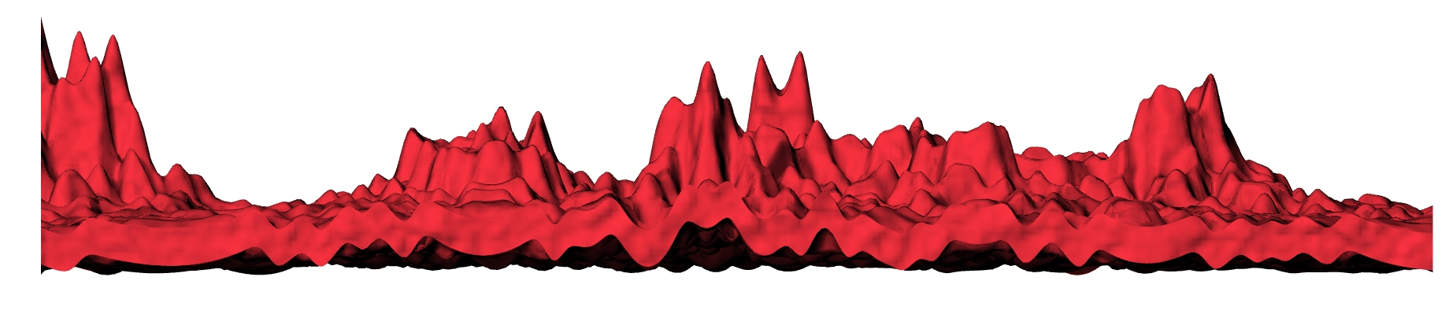
P#
<Computational Design Thinking>
<Parametric Design>
P#
1/2
1/2
1/2
1/2
Captions
01 Description
02 Front view
03 Perspective view
04 Right view
01
02
03
04

